Slide 1
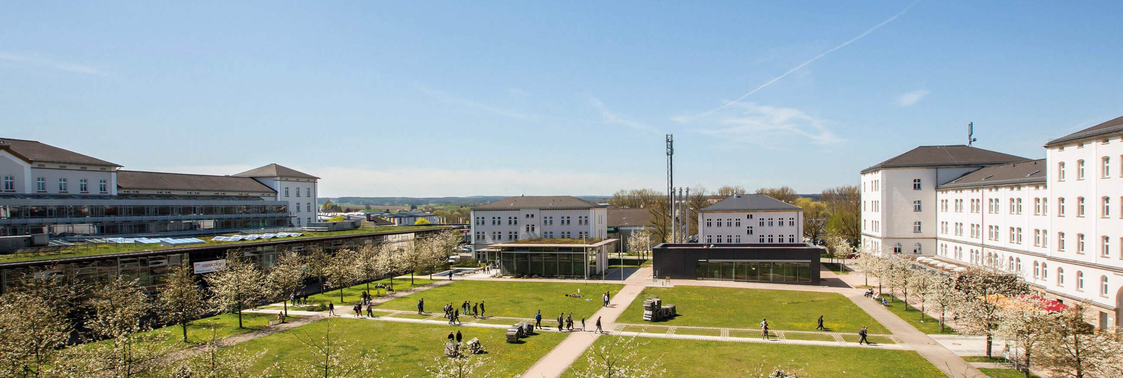
Explainable AI using class activation mappings in Pytorch
Summer Semester 2024
Author: Nitesh Morem, Kashif Riyaz
Under the guidence of Prof. Dr.-Ing. Christian Bergler | OTH Amberg-Weiden

Slide 2
Content
01
Introduction.
04
Results.
02
Data Preprocessing.
05
Conclusion.
03
Methodology.

Slide 3
INTRODUCTION
Artificial intellegence as Black Box. (E.g. ChatGPT,Gemini)
Transparency and interpretability. (Use of AI in Sensitive Domains).
Importance of transparency and interpretability in AI. (E.g. The Japanese/South korean Incident).
Goals of the project to improve AI model interpretability. (How can be Trust AI)
Question: What techniiques do you Think we can use to improve the transparency or how can we Trust AI as it is NOW?
Quellen:

Slide 4
Techniques and Visualization
Grad-CAM
Grad-CAM++
Eigen-CAM
XGrad-CAM

Slide 5
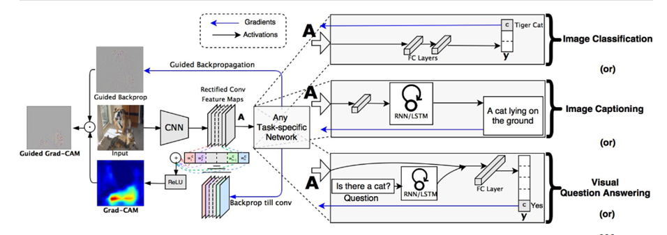
Grad-CAM
It uses 2D activations and gradients to highlight the key parts in an image.
Source: https://openaccess.thecvf.com/content_ICCV_2017/papers/Selvaraju_Grad-CAM_Visual_Explanations_ICCV_2017_paper.pdf

Slide 6
Grad-CAM
Advantages:
Easy to implement.
Computationally Efficient.
Suitable for real time applications.
Disadvantage:
Struggles to provide accurate localization.

Slide 7
Grad-CAM++
It uses higher order derivates to provide more precise and detailed visualization.
Advantages:
Improved localization.
Improved precision.
Disadvantage:
More computationally complex.

Slide 8
Eigen-CAM
It uses principal component analysis(PCA) to identify more significant components in the input image.
Advantages:
Capture trends in feature maps.
Provides unique perspective on important regions compared to gradient based approach.
Disadvantages:
Computationally difficult because of PCA.
Interpretation of PCA is less insightful.

Slide 9
XGrad-CAM
It is also known as Axiom-based Grad-CAM.
It improves on Grad-CAM by incorporating concept of guided backpropagation to produce sharper visualization.
Advantages:
Enhanced Accuracy
Versatility
Disadvantages:
Computational Complexity.
Implementation challenges.

Slide 10
2. Data Preprocessing
Use of publicly available images from Google.
Steps for preprocessing images:
Loading.
Resizing.(224x224)
Normalizing.
standardizing.{mean=[0.485, 0.456, 0.406] and standard deviation=[0.229, 0.224, 0.225] }

Slide 11
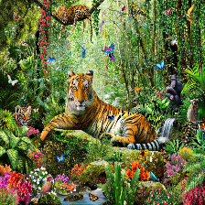
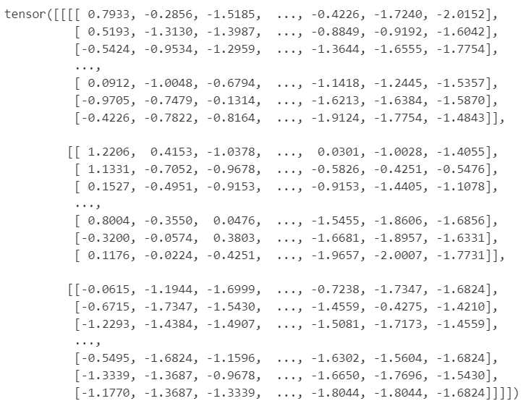
Image into Tensor
Source:https://images.photowall.com/products/56851/tiger-in-the-jungle.jpg?h=699&q=85

Slide 12
3. Methodology
Framework overview
The framework is divided into five parts:
Importing modules.
Defining functions.
Image_transform().
Predict_and_get_target().
Get_conv_layer().
Importing image and model.
CAM visualization Techniques.
Visualization.

Slide 13
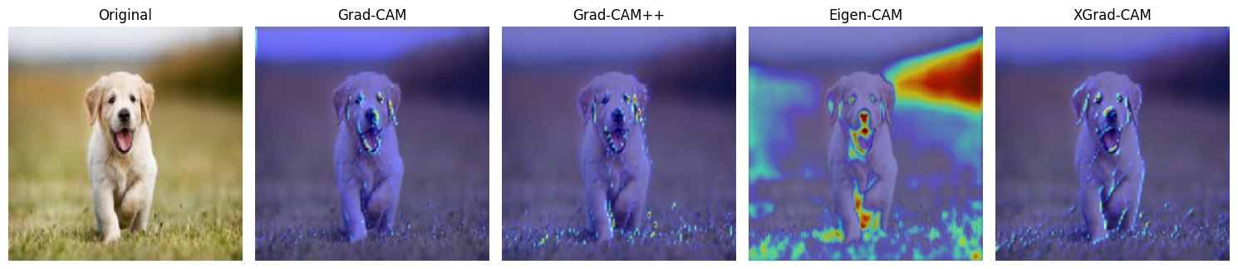
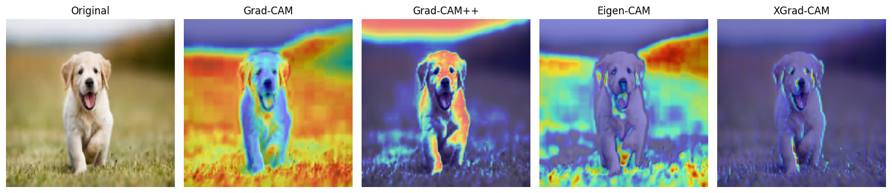
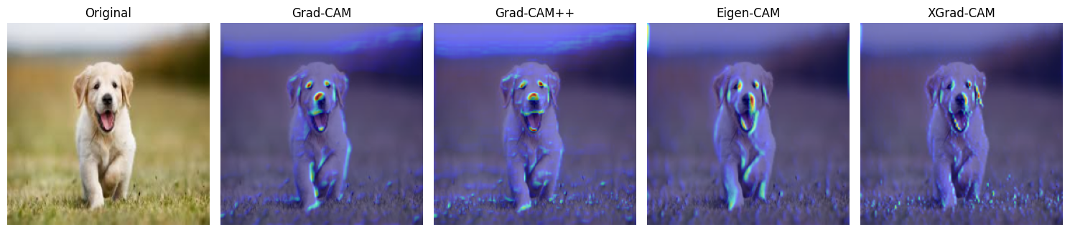
5. Results and disscussion
Heat maps
Heat map for first layer
Resnet152
Inception_v3
Densnet121

Slide 14
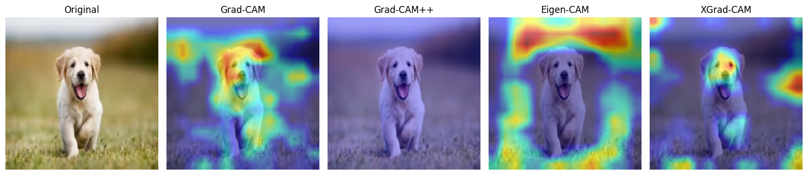
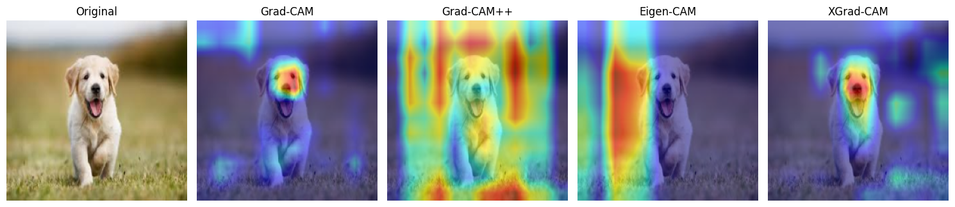
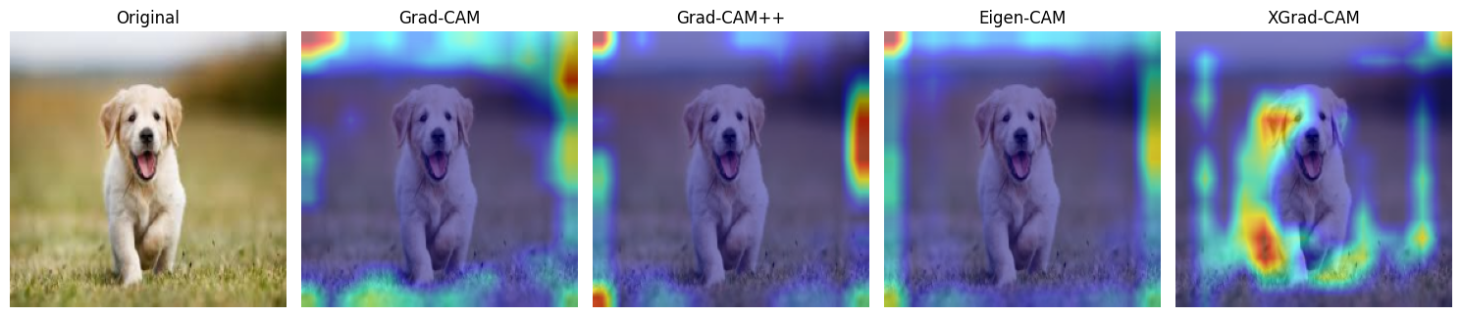
Heat maps
2. Heat map for middle layer
resnet152
Inception_v3
Densnet121

Slide 15
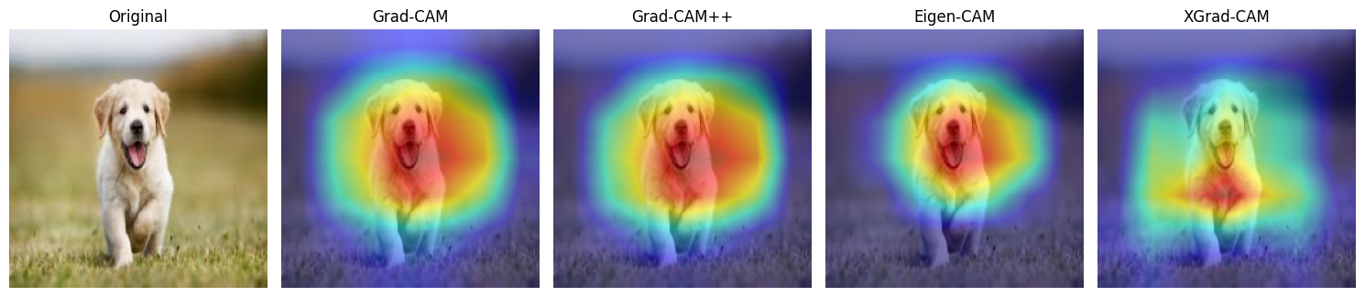
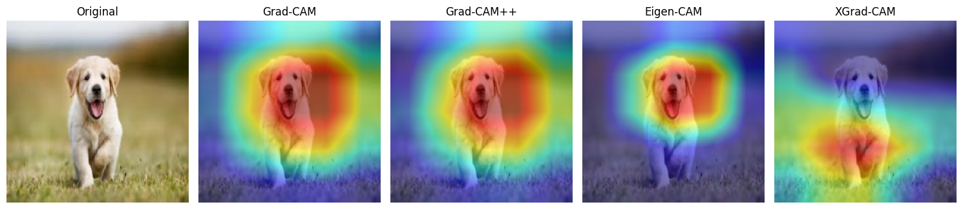
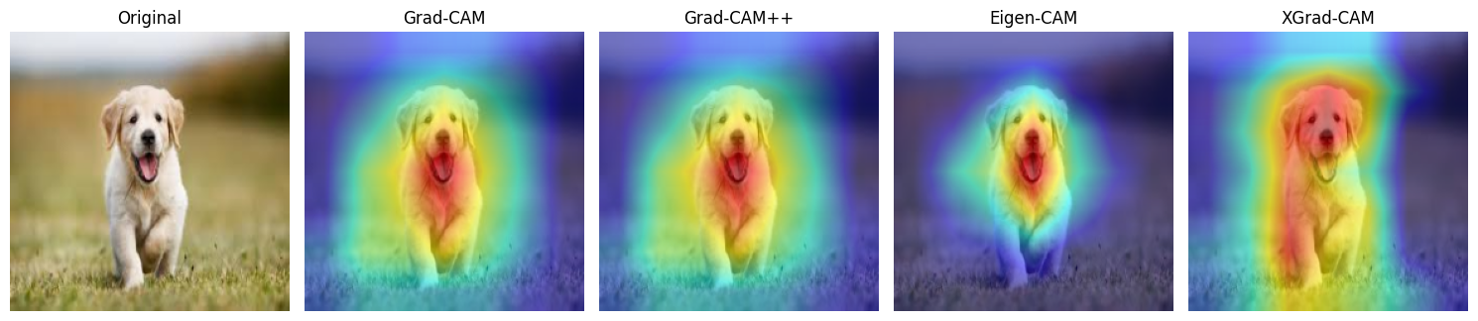
Heat maps
3. Heat map of Last convolutional layer.
Resnet152
Inception_v3
Densnet121

Slide 16
5. Conclusion
All the visualization methods surpass each other in different criteria.
Grad- CAM provides a good balance of performance and interpretability but sometime is less precise and produces noisy heatmaps.
Grad-CAM++ shows good performance involving multiple objects and generally provides better localization and sharper heatmaps than Grad-CAM.
Eigen-CAM shows those features which the network deems important without constraining itself to a particular class.
XGrad-CAM provides more precise visualization compared to standard Grad-CAM. However, the results suggest that it might not always outperform Grad-CAM.

Slide 17
Future Scope
Improved image preprocessing for diverse models.
Expanding Explainable AI to NLP.
Framework for multi-layer sequence highlighting

Slide 18
Q/A Time

Slide 19
Vielen Dank!
Ostbayerische Technische Hochschule (OTH) Amberg-Weiden Kaiser-Wilhelm-Ring 23 | 92224 Amberg

